Slide 1
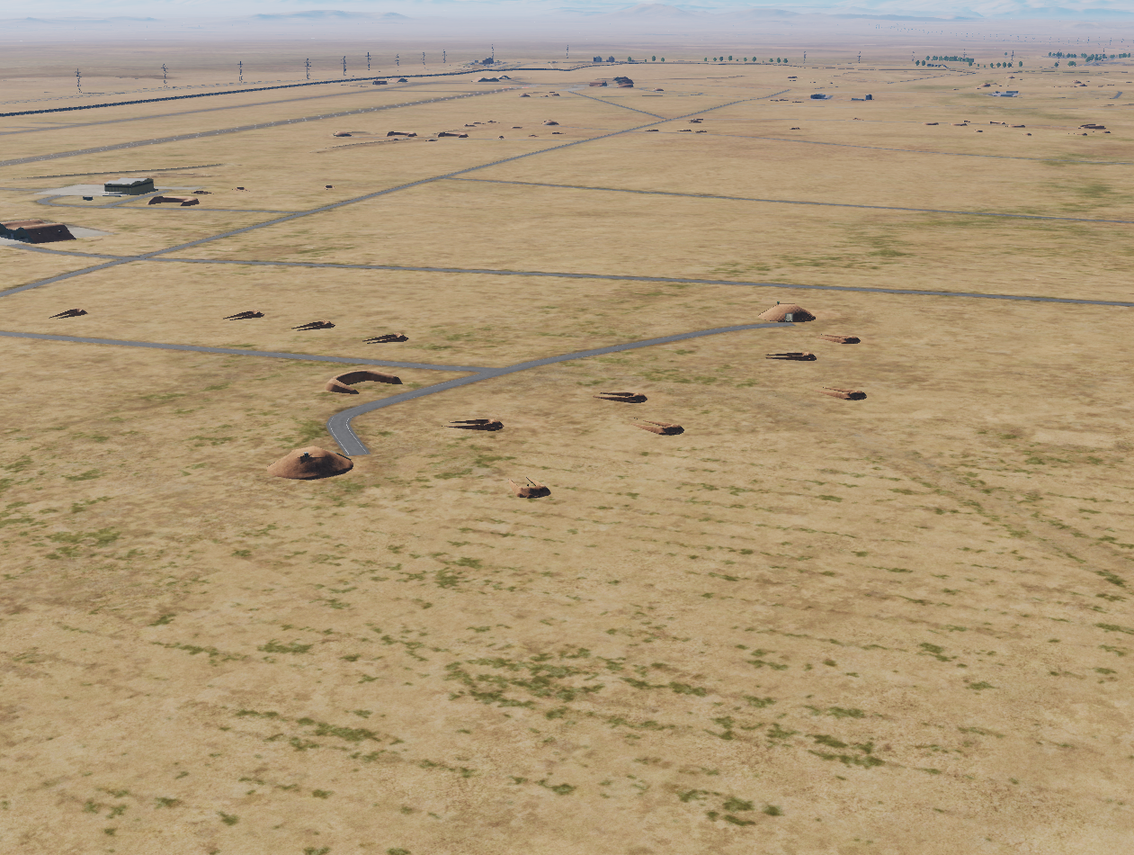
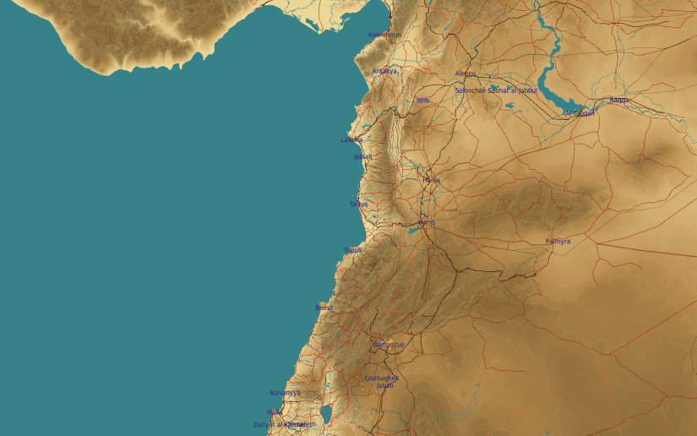
OPARTGT073 70th Air Division Headquarter
N
OPARTGT073B
2
1
73
DESCRIPTION OF THE DESIRED POINTS OF IMPACT WITH WPN TYPE:
OPARTGT073A – Bunker Entrance South
DPI 1 N33 04.108 E036 33.455/2348ft/(2000 Ibs bomb)
OPARTGT073B – Bunker Entrance North
DPI 2 N33 04.275 E036 33.431/2353ft/(2000 lbs bomb)
3 Storey bunkers made of reinforced concrete slab supported by reinforced concrete base and pillars, flat reinforced poured roof, covered with approximately 2m of earth. Requires delayed fuzing.
Suggested fuzing solution on DPIs 1-2 –Delayed fuzing to pierce through floors and affect building integrity and structure.
OPARTGT073A
4
5
6
DPI’s relate to centre of infrastructure requiring destruction.
7
8

